Slide 1

Intro to Tor
Jaxon Haws

Slide 2
DISCLAIMER
Congrats! You’re now **probably** on a government watchlist!
DON’T DO ANYTHING TO GET YOURSELF ARRESTED

Slide 3
2ND DISCLAIMER
Yay! I always wanted to be on a government watchlist!
MORE IMPORTANTLY, DON’T DO ANYTHING TO GET ME ARRESTED

Slide 4
Table of Contents
What is Tor?
How does Tor work?
What can you browse with Tor?
How secure is Tor?

Slide 5

What isn’t Tor?
The Dark Web
The Deep Web
Illegal (at least in the U.S.)
A VPN
Torrenting
Completely foolproof

Slide 6
What is Tor?
Tor – The Onion Router
Free and open-source software for enabling anonymous communication
Can be used in the form of a proxy for individual applications/whole system or as a browser
Tor directs Internet traffic through a free, worldwide, volunteer overlay network, consisting of more than six thousand relays

Slide 7
Tor History
1995 – Concept of onion routing was created
2002 – Tor network began being deployed
2006 – Tor project founded by computer scientists Roger Dingledine, Nick Mathewson and five others
2008 – Tor browser was released
2013 – Edward Snowden used Tor

Slide 8
Tor based operating systems
Tails
Whonix
Qubes OS

Slide 9
How does Tor work?

Slide 10
Tor Nodes: Guards, Bridges, Relays, & Exit Nodes
Guards
  Publicly Registered Entry Nodes
  Forward request/data to relay from users
Bridges
  Privately Registered Entry Nodes
Relays
  Middleman: receive requests from other nodes and forwards them to another node
Exit Nodes
  Sends content to final location/server/website
  Retrieves content from final location/server/website and sends to relay

Slide 11
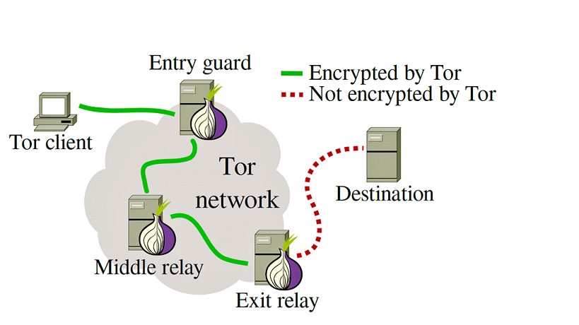
The Onion Router

Slide 12
Onion Services (*.onion)
Basically URLs, generated based on a public key when an onion service is configured
16 characters long for V2 (base32 80 bit hash)
56 characters long for V3 (256-bit ed25519 public key, version number, and a checksum)
Strings containing any letter and/or digits 2-7
Require onion routing to access

Slide 13
What can you browse with Tor?

Slide 14
Surface web
Any public websites indexed by a search engine
  duckduckgo.com
  eff.org
  torproject.org
  cpsecurity.club
  cplug.org

Slide 15
Deep web
Anything that is not indexed by publicly accessible search engines
Onion sites
  See examples ->

Slide 16
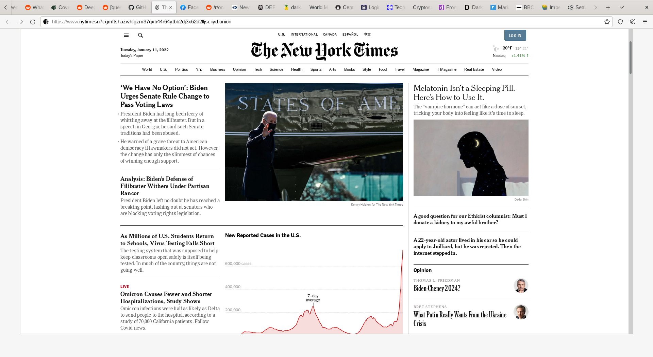
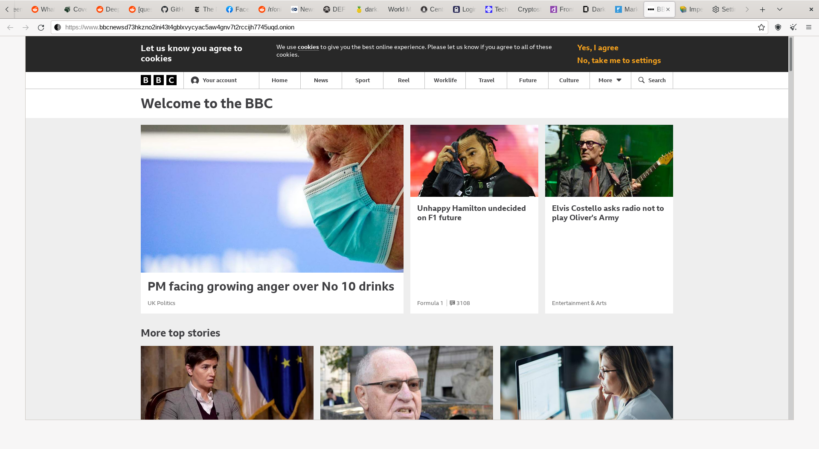
Journalism
https://www.nytimesn7cgmftshazwhfgzm37qxb44r64ytbb2dj3x62d2lljsciiyd.onion
https://www.bbcnewsd73hkzno2ini43t4gblxvycyac5aw4gnv7t2rccijh7745uqd.onion

Slide 17
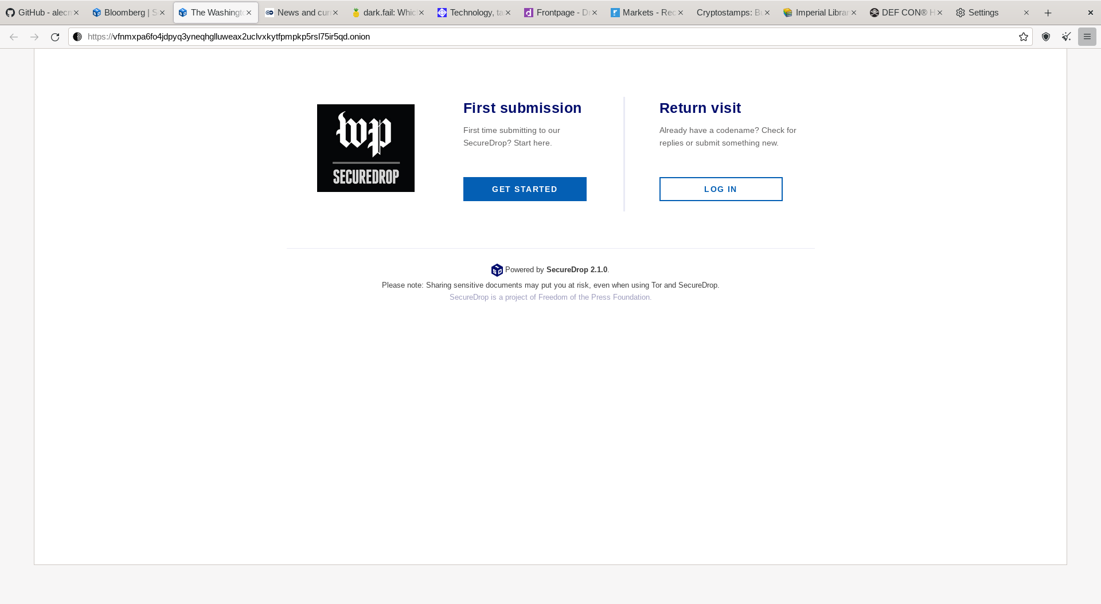
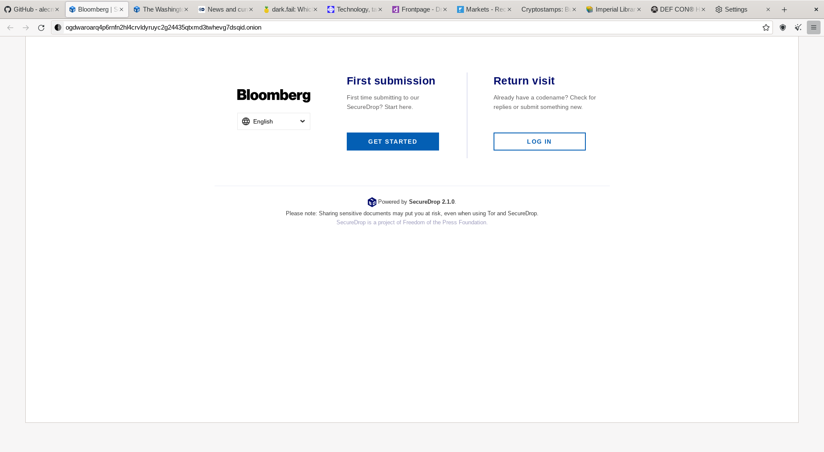
SecureDrops
https://vfnmxpa6fo4jdpyq3yneqhglluweax2uclvxkytfpmpkp5rsl75ir5qd.onion
http://ogdwaroarq4p6rnfn2hl4crvldyruyc2g24435qtxmd3twhevg7dsqid.onion

Slide 18
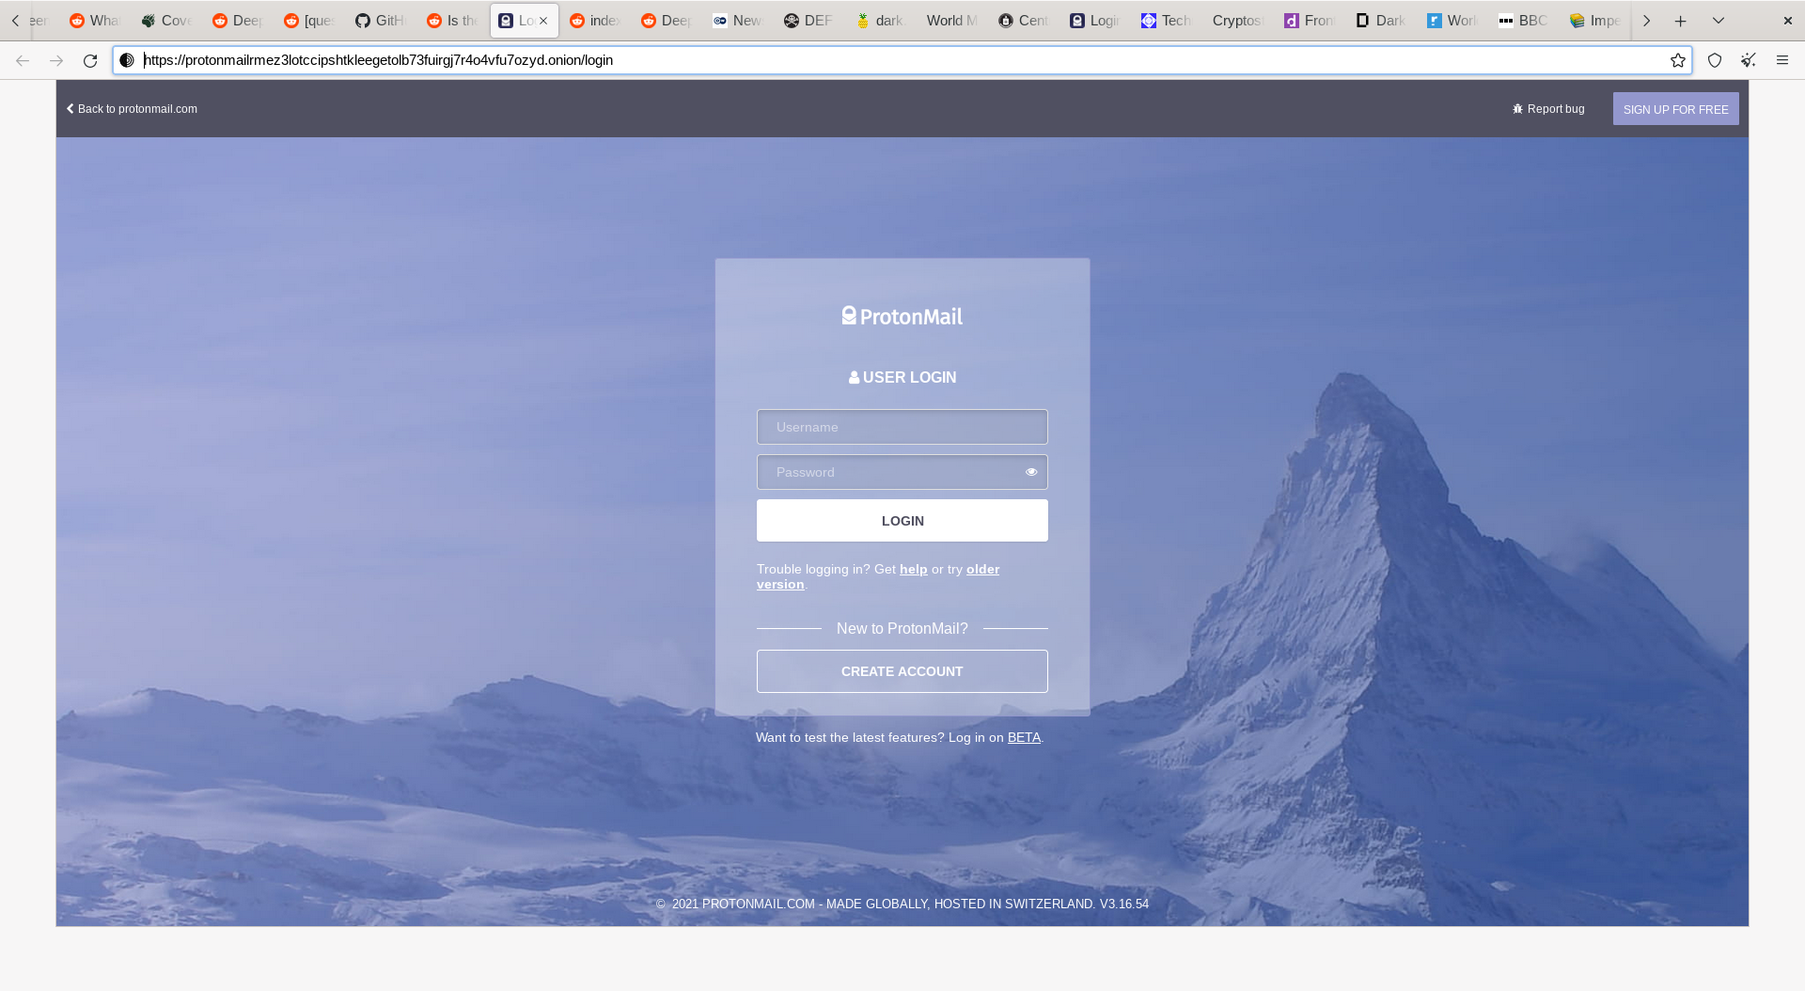
Email
https://protonmailrmez3lotccipshtkleegetolb73fuirgj7r4o4vfu7ozyd.onion

Slide 19
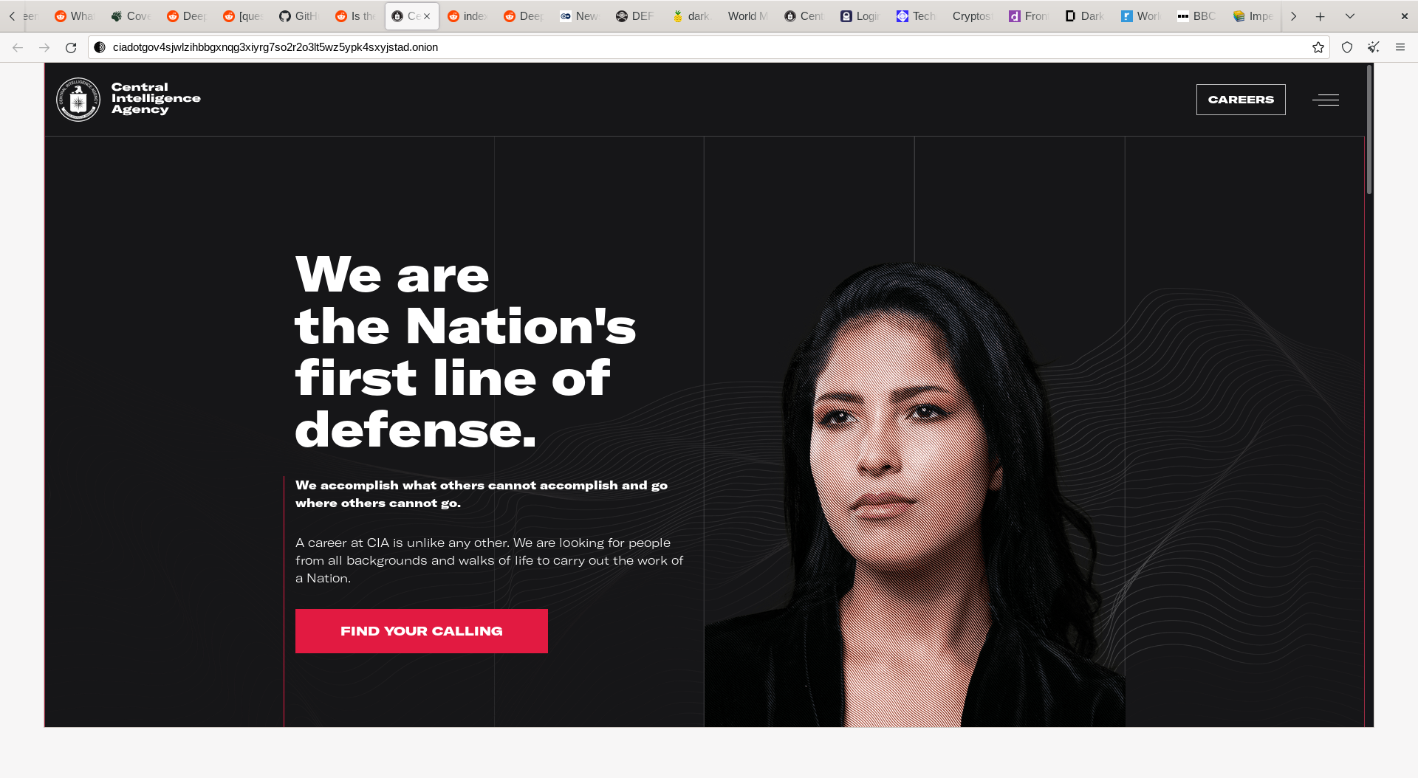
Law Enforcement
http://ciadotgov4sjwlzihbbgxnqg3xiyrg7so2r2o3lt5wz5ypk4sxyjstad.onion

Slide 20
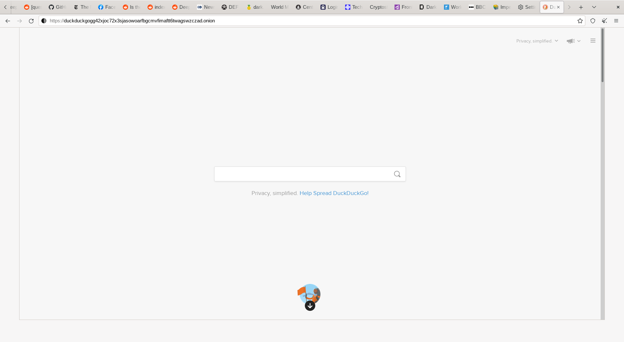
Search Engines
https://duckduckgogg42xjoc72x3sjasowoarfbgcmvfimaftt6twagswzczad.onion

Slide 21
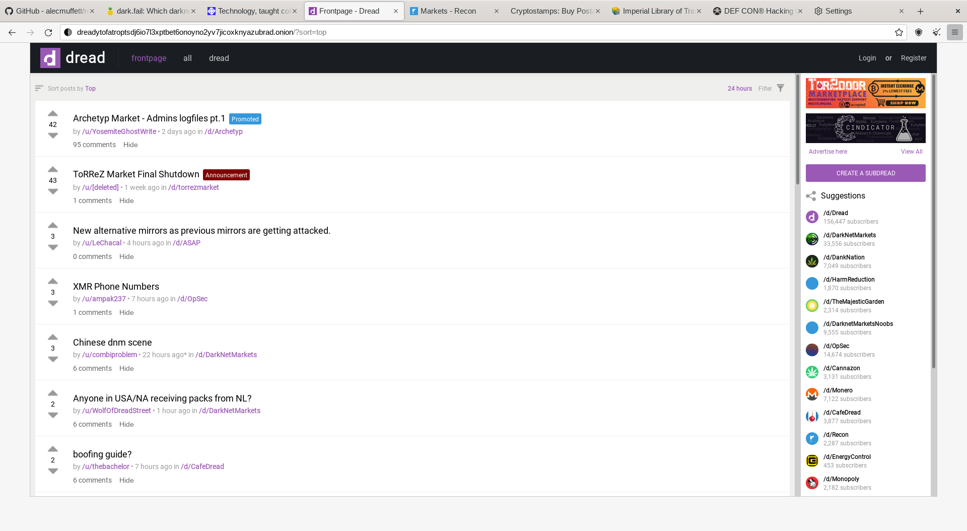
Forums

Slide 22
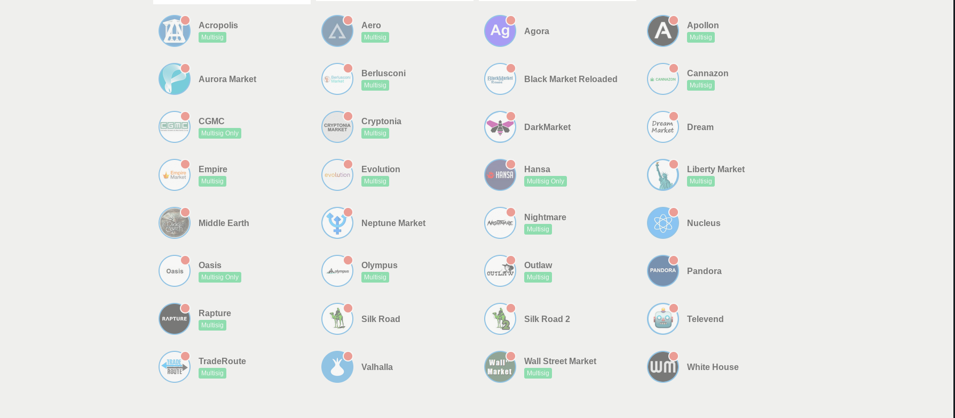
Marketplaces?

Slide 23
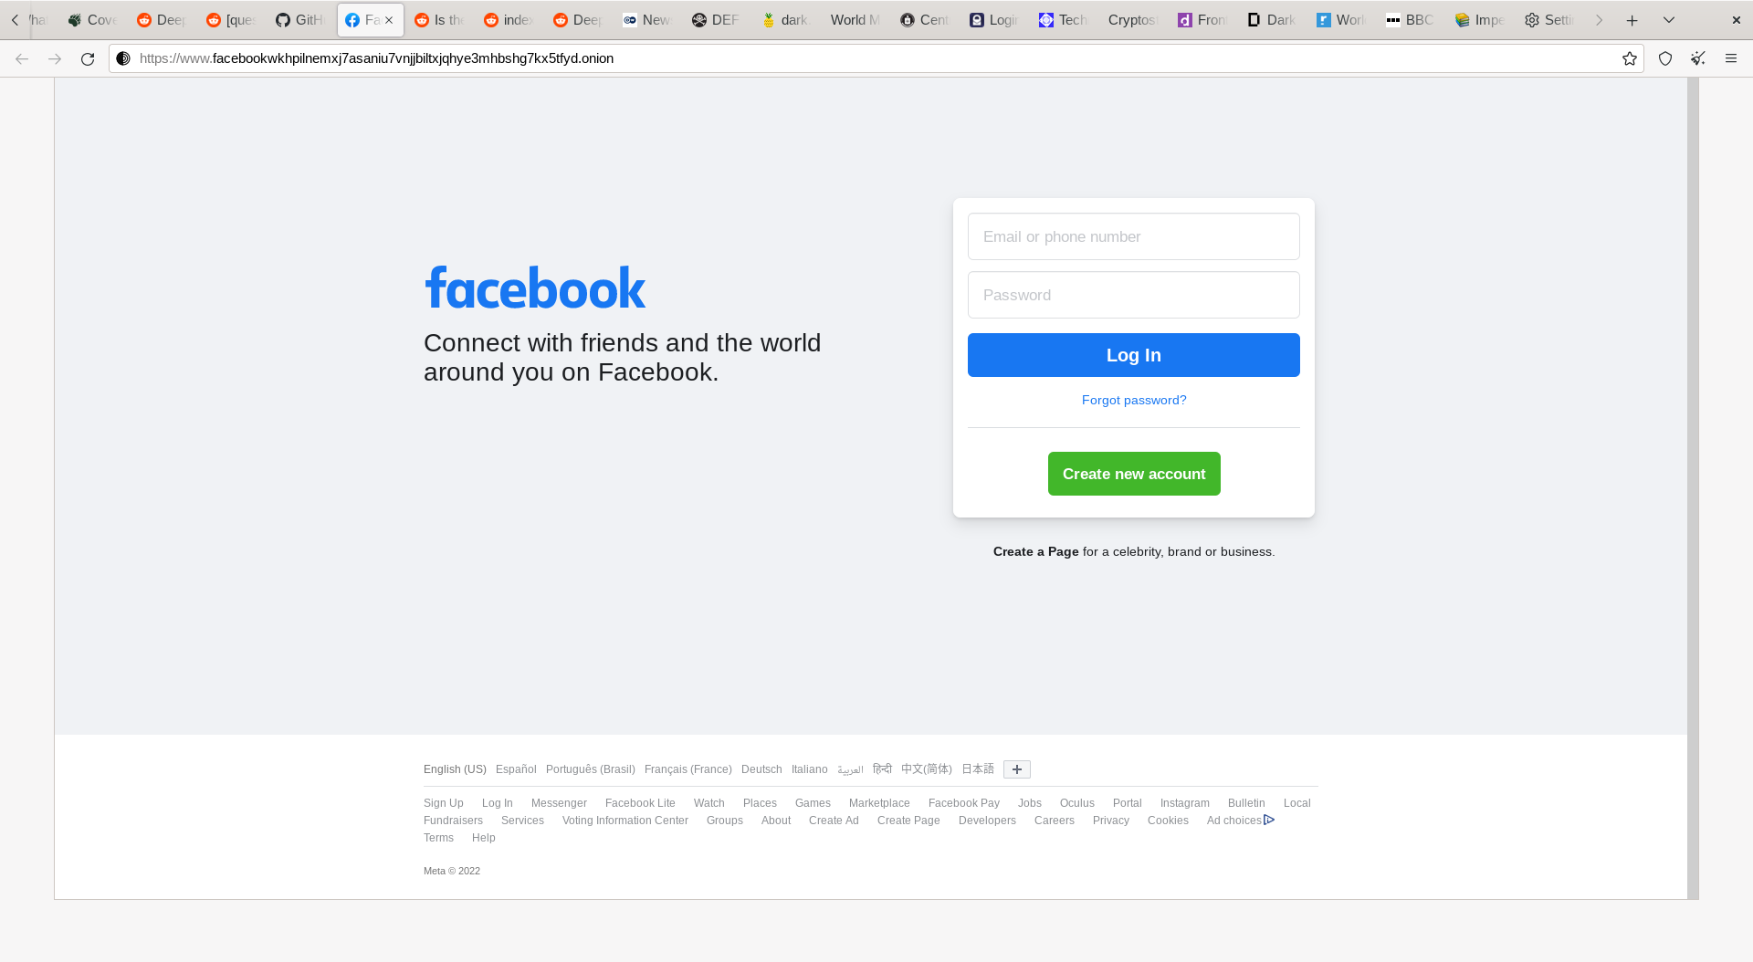
Facebook?
https://www.facebookwkhpilnemxj7asaniu7vnjjbiltxjqhye3mhbshg7kx5tfyd.onion

Slide 24
How secure is Tor?

Slide 25
Pretty secure
Problems really only exist at entry/exit nodes

Slide 26
Browser Fingerprinting
A digital fingerprint is created when a company makes a unique profile of you based on your computer hardware, software, add-ons, and even preferences.
Tor browser sessions are designed to all look identical
See your browser’s fingerprint here:
  Coveryourtracks.eff.org

Slide 27
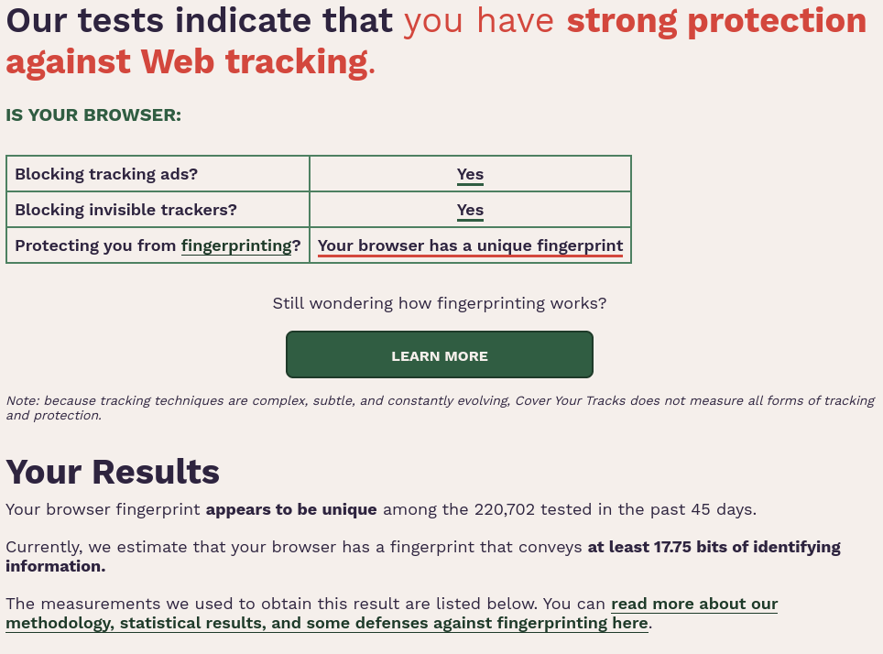
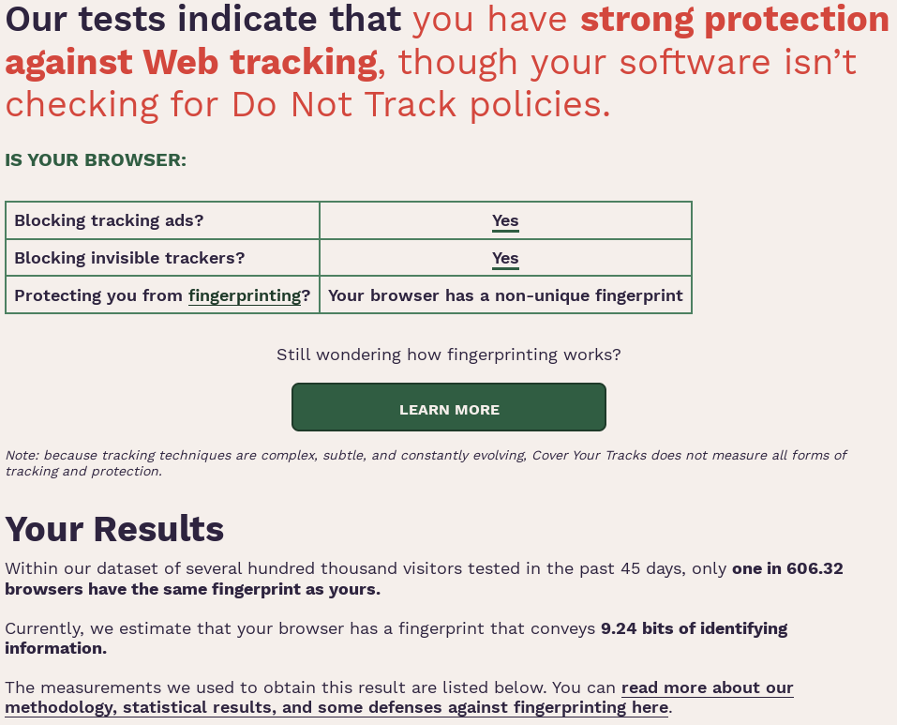
Browser Fingerprinting:
Personal Firefox vs Tor Browser

Slide 28
Sources
https://www.torproject.org/
https://wiki.archlinux.org/title/Tor
https://hackernoon.com/how-does-tor-really-work-c3242844e11f
https://www.reddit.com/r/onions/
https://www.reddit.com/r/TOR/
https://en.wikipedia.org/wiki/Tor_(network)
https://en.wikipedia.org/wiki/.onion

